Slide 1
Open Access
Expansion Planning
14 April 2021

Slide 2
Growth of OA Articles at KU
Source: Scopus

Slide 3
Brief History
Fall 2019
Program launched by Provost and assigned to the library
Selected ACS, IEEE, and Wiley as initial publishers
Required that journals be rated as Q1 by Scimago, Scopus, and Clarivate
Spring 2020
Contracts signed
Three training sessions for authors
Six APC approvals
Fall 2020
Three training sessions for authors
49 APC approvals
Spring 2021
Two training sessions
31 APC approvals

Slide 4
Article Output
As of 14 April 2021

Slide 5
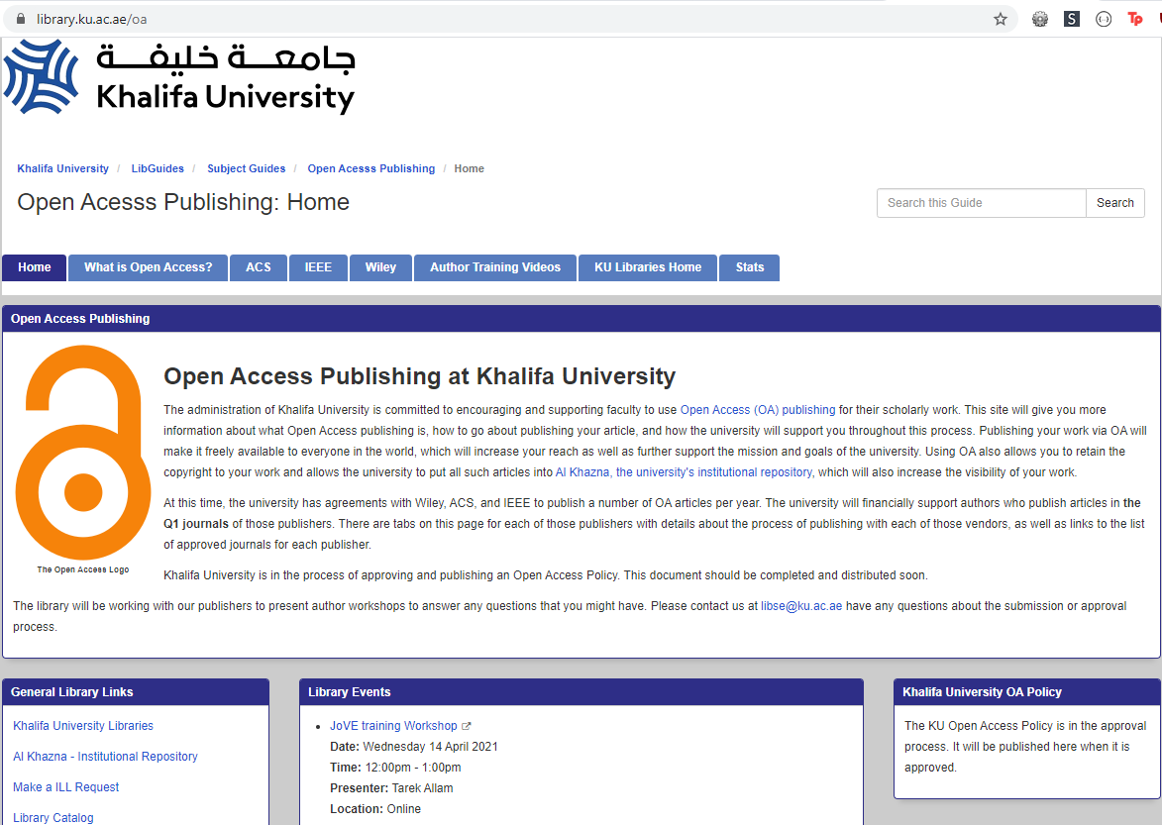
KU Open Access Website
https://library.ku.ac.ae/oa/

Slide 6
Expanding the Project**
**Dependent on funding
List presented to ALC, compiled from
Study conducted by librarians of most used by KU authors
Recommendations from the faculty
ALC approved five:
Multidisciplinary Digital Publishing Institute (MDPI)
Frontiers
Scientific Reports by Nature
PLOS ONE
Elsevier

